Slide 1
Getting Started with Swagger Tools
INTRODUCTION

Slide 2






Swagger Tools
Swagger Editor
Swagger UI Swagger Inspector
Swagger Codegen
OpenAPI
SwaggerHub

Slide 3

Swagger API and OpenAPI
Swagger API
OpenAPI

Slide 4
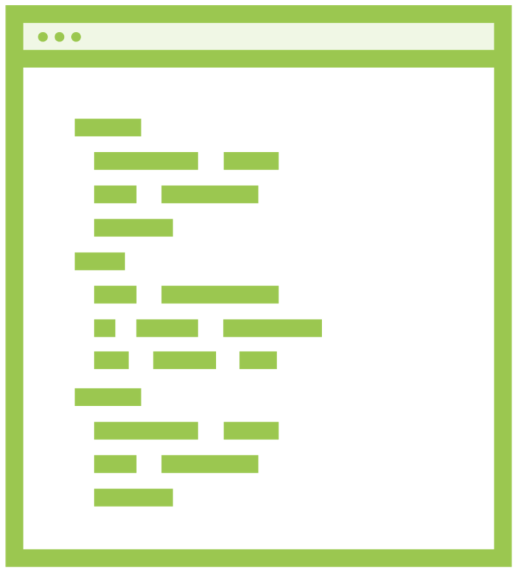







RESTful Web Services Documentation
API DOCs
API DOCs
API DOCs
API DOCs
Company A
Company B
Company C
Company D
No Standard

Slide 5


Swagger API and OpenAPI Timeline
Swagger API
2011

Slide 6



Swagger API and OpenAPI Timeline
Swagger API
2011
OpenAPI Initiative
2015

Slide 7


Swagger API and OpenAPI Timeline
Swagger API
2011
Swagger > OpenAPI
2016
OpenAPI Initiative
2015

Slide 8


Swagger API and OpenAPI Timeline
Swagger API
2011
Swagger = OpenAPI
2016
OpenAPI Initiative
2015
OpenAPI 3.0
2017

Slide 9
Swagger Tools
Swagger Editor
Swagger UI Swagger Inspector
Swagger Codegen
OpenAPI
SwaggerHub

Slide 10

Overview
Overview of Swagger Tools
Setup free Swagger account Explain demo

Slide 11
The Swagger Tools

Slide 12
Swagger Tools
Swagger Editor
Swagger UI Swagger Inspector Swagger Codegen SwaggerHub

Slide 13

Swagger Editor

Slide 14
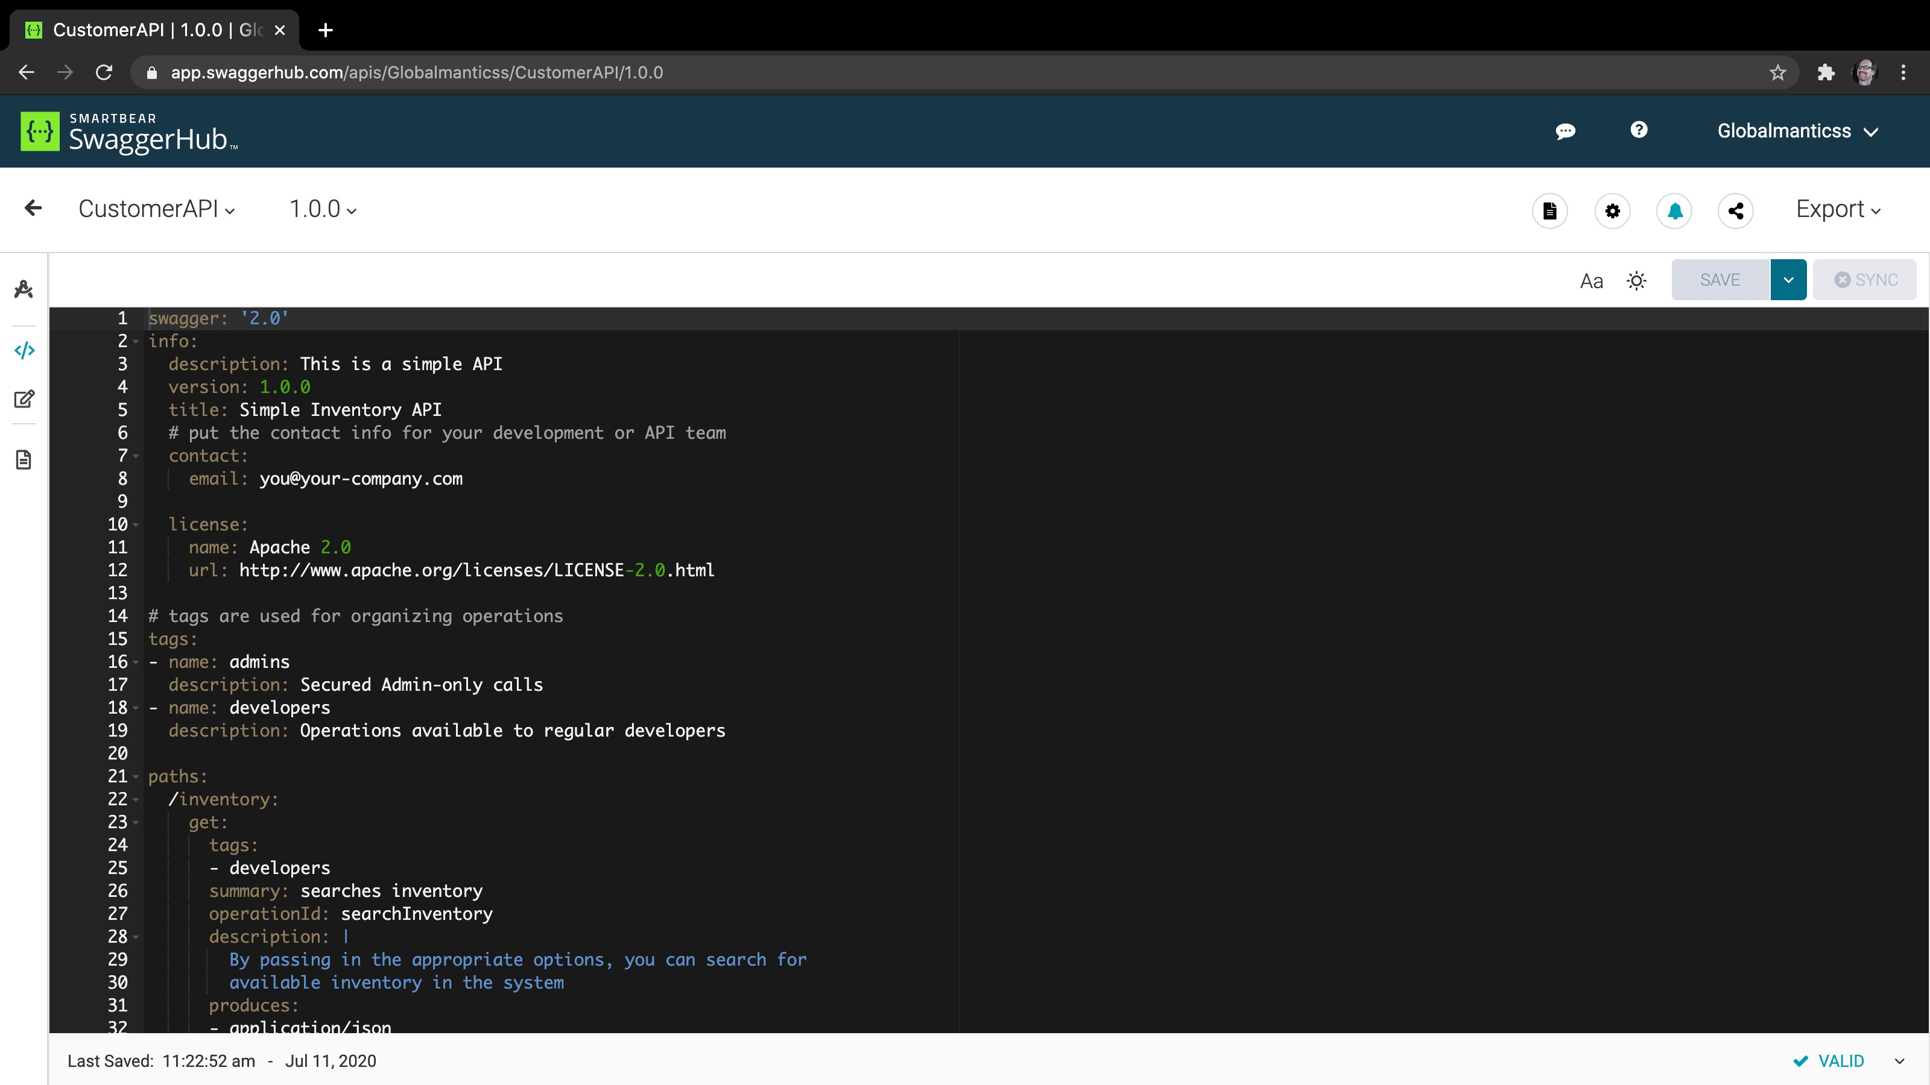
Swagger Editor

Slide 15
Swagger UI

Slide 16
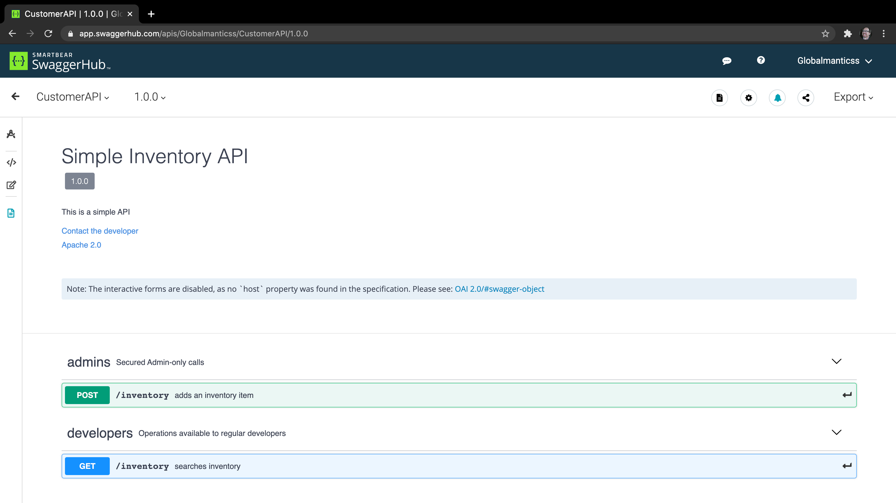
Swagger UI

Slide 17
Swagger Inspector

Slide 18
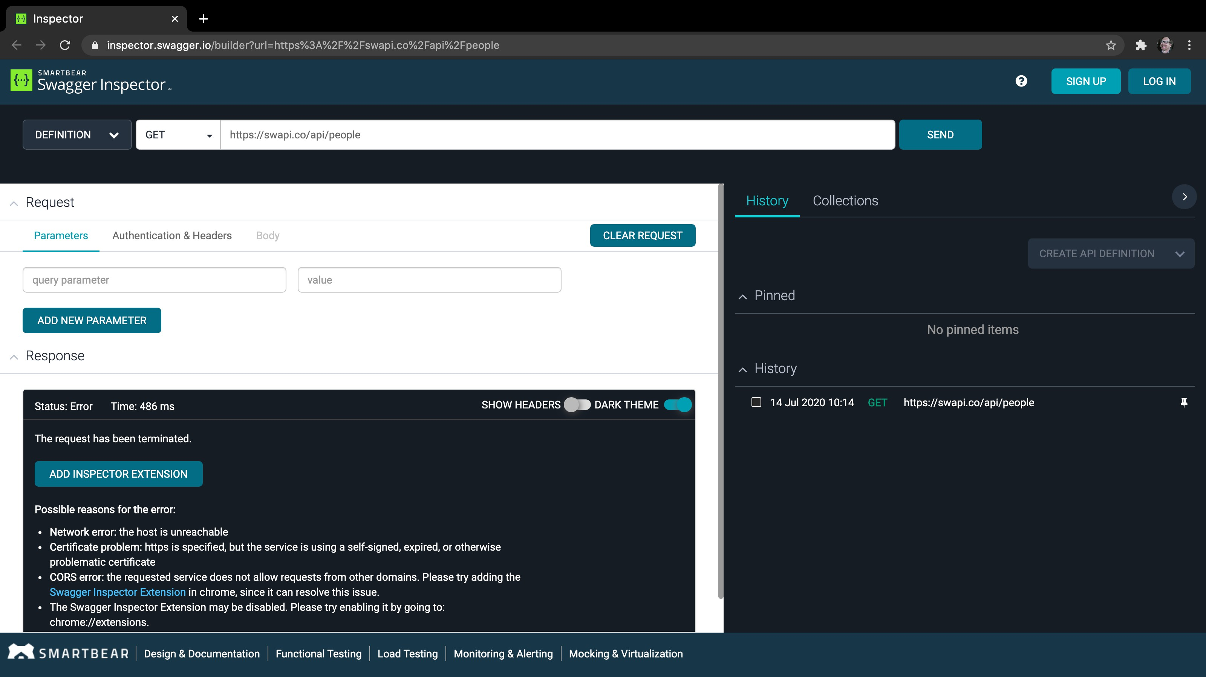
Swagger Inspector

Slide 19
Swagger Codegen

Slide 20
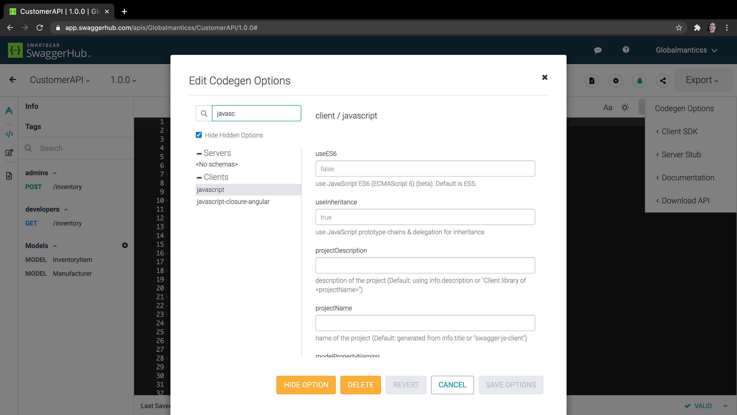
Swagger Codegen

Slide 21


Swagger Tools
 | Swagger Editor
Swagger UI Swagger Inspector
 | Swagger Codegen
Open Source
SwaggerHub
Commercial

Slide 22
SwaggerHub

Slide 23
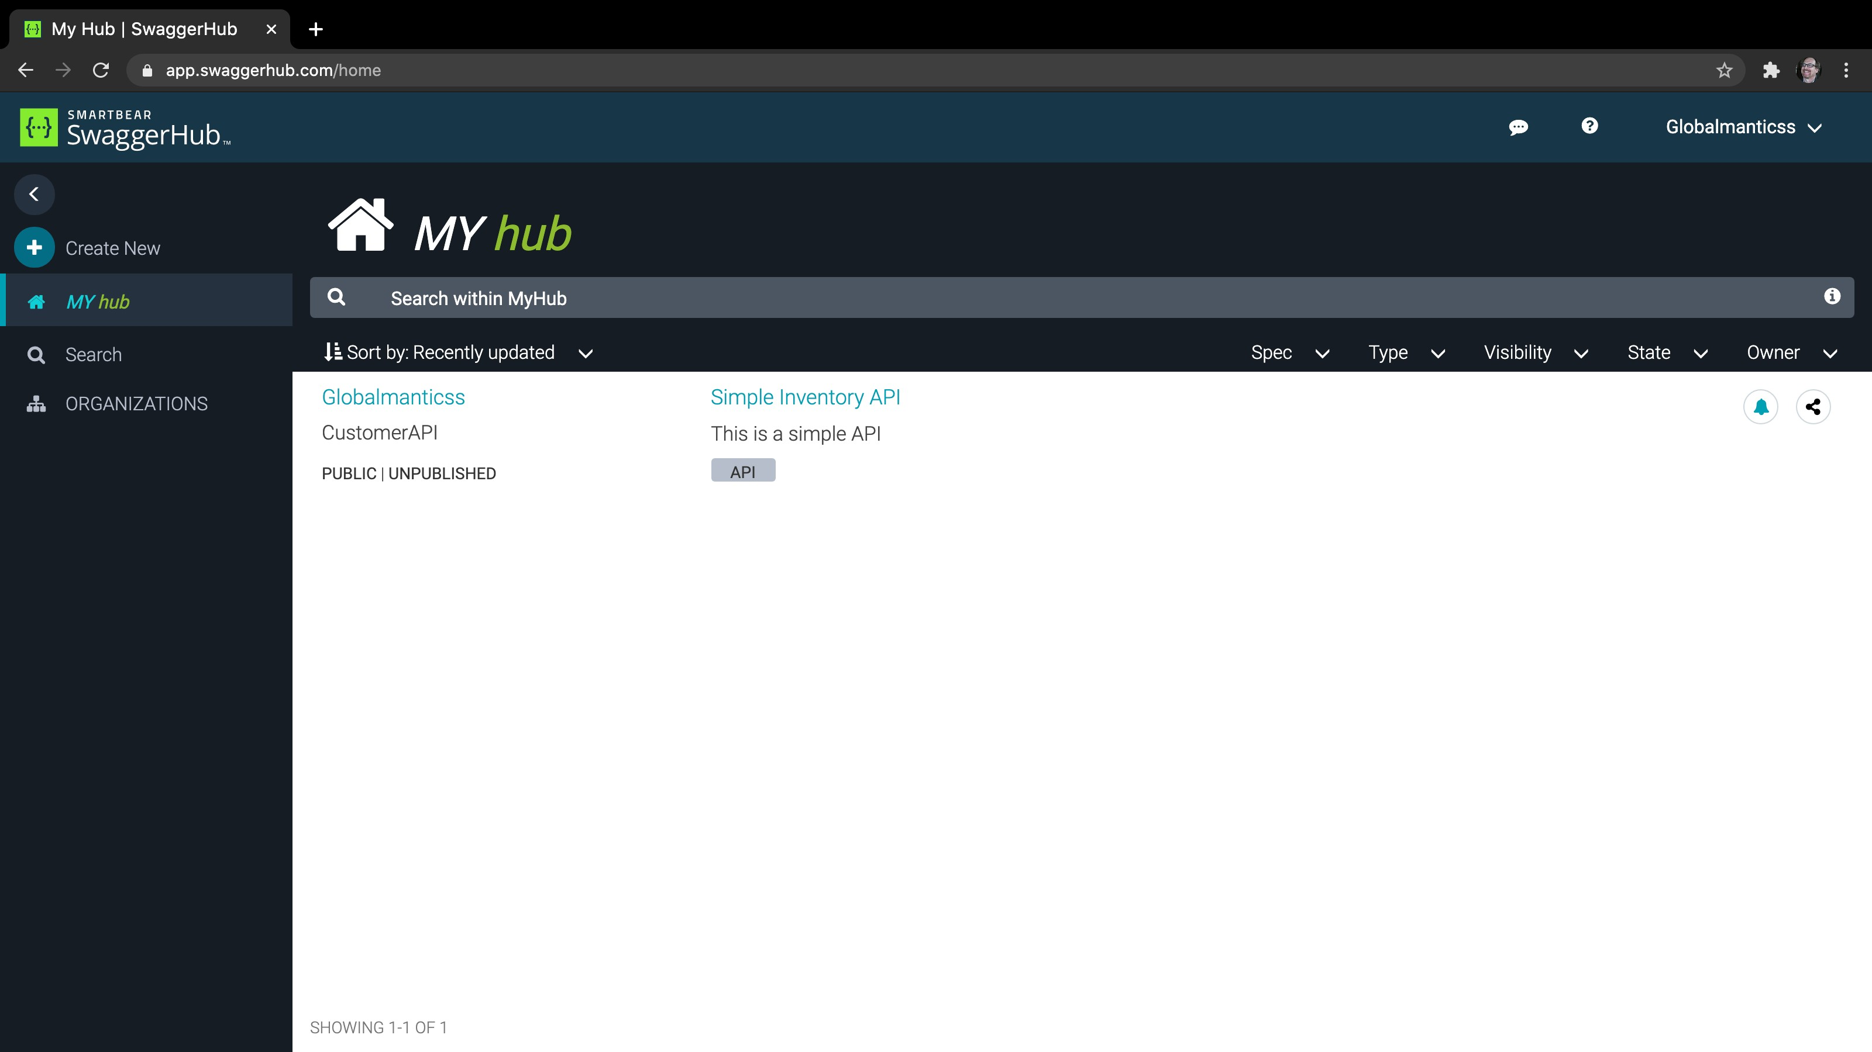
SwaggerHub

Slide 24
Setup Free Swagger Account

Slide 25
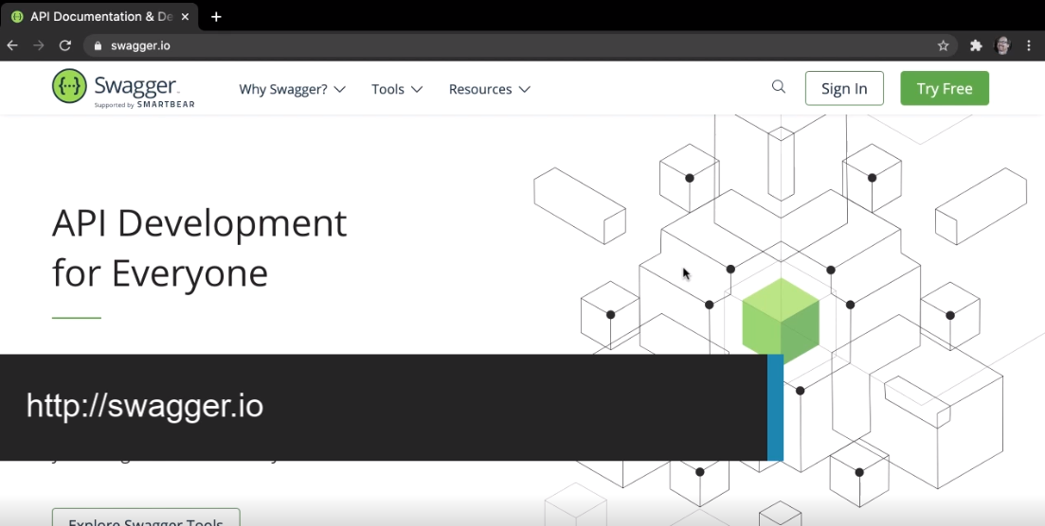

Slide 26
Swagger Free Account

Slide 27
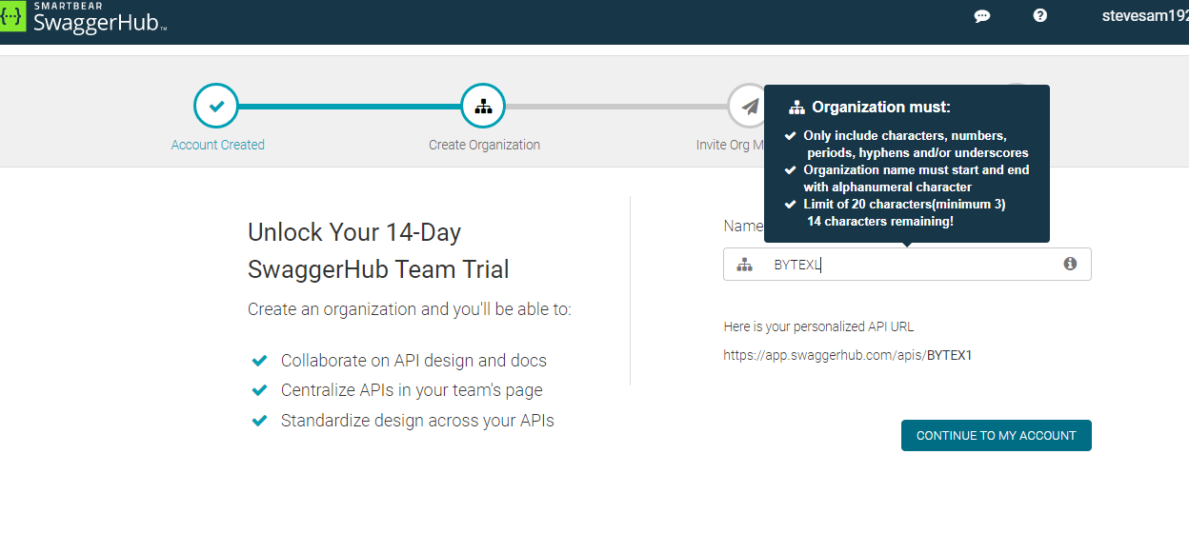

Slide 28
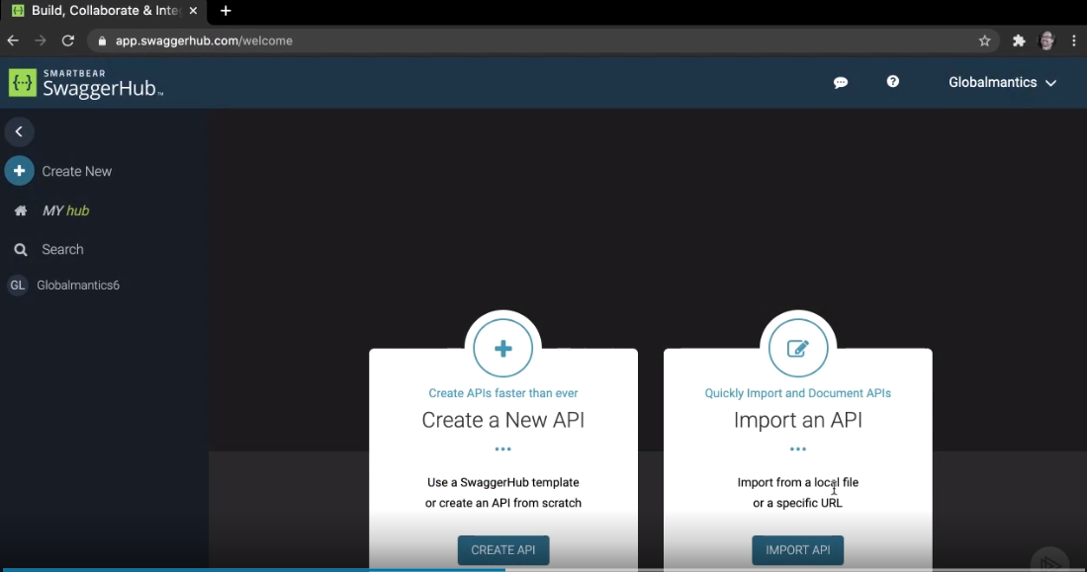

Slide 29
Swagger On-premises

Slide 30
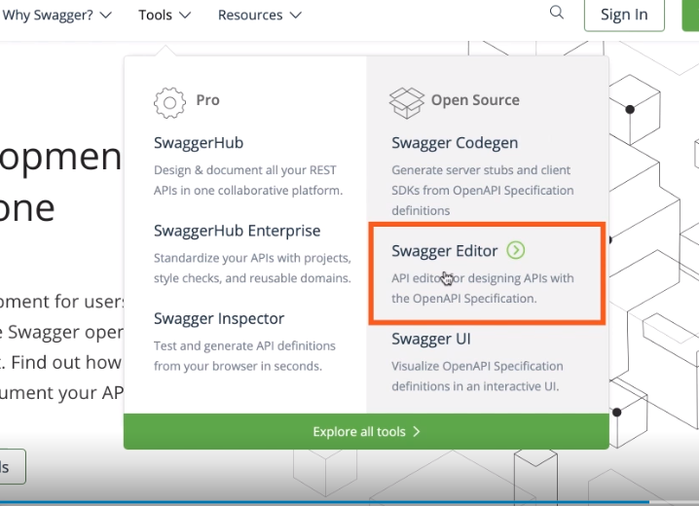

Slide 31
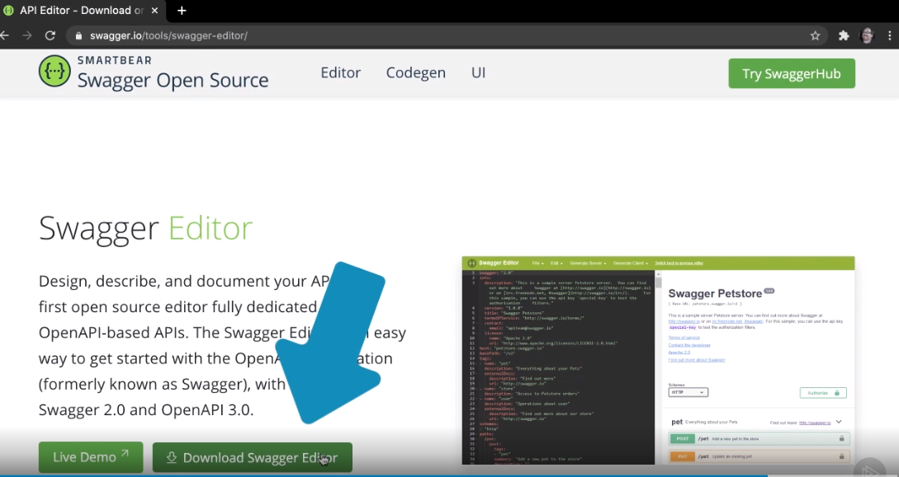

Slide 32
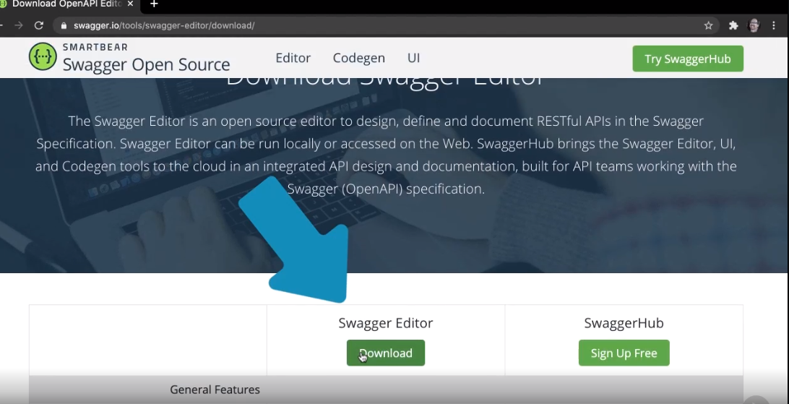

Slide 33
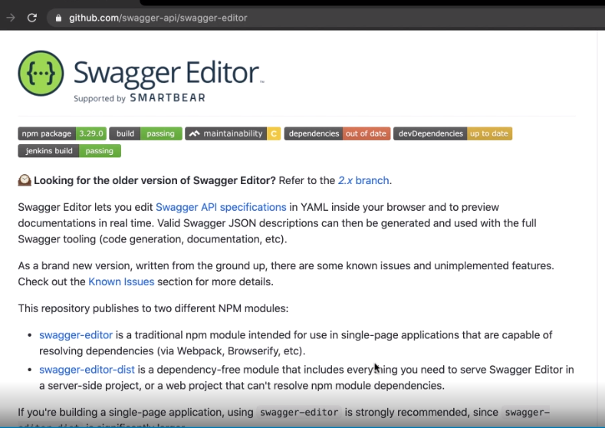

Slide 34
The Demo Code

Slide 35

Globalmantics: CRM cloud service
Design and document RESTful web service
Customer data
Customer Id
Customer name
Address
Contacts
Customer API
Create new customer
View customer
Update customer
Remove customer
Demo

Slide 36
History of Swagger and OpenAPI
Swagger 2.0 = OpenAPI 2.0
OpenAPI 3.0 Swagger Tools
Swagger Editor
Swagger UI
Swagger Inspector
Swagger Codegen
SwaggerHub
Summary

